Slide 1
Hacker Techniques, Tools, and Incident Handling
Chapter 7
Enumeration and Computer System Hacking

Slide 2
Learning Objective
Perform system hacking, and web and database attacks.

Slide 3
Key Concepts
Process of enumeration, system hacking, and password cracking
Tools used to perform enumeration
Privilege escalation
Importance of covering your tracks
Backdoors

Slide 4
Windows Basics
Windows operating systems
Can be used as a standalone or networked operating system
Must secure the operating system and any software running on the computer in networked environments
Number of Windows features makes security an issue

Slide 5
Controlling Access in Windows
Users
Groups
SIDs

Slide 6
Windows Users
The user account is the fundamental object in Windows that is used to determine access to file shares, services that keep the system functioning, and more
Processes in Windows are run under one of four user contexts:
Local Service
Network Service
SYSTEM
Current User
Notes:
Local Service—A user account with greater access to the local system but limited access to the network.
Network Service—A user account with greater access to the network but limited access to the local system.
SYSTEM—A super-user style account that gets nearly unlimited access to the local system and can perform actions on the local system with little or no restriction.
Current User—The currently logged-in user who can run applications and tasks, but still is subject to restrictions that other users are not subject to. The restrictions on this account hold true even if the user account being used is an Administrator account.

Slide 7
Windows Users (Cont.)
User account information can be physically stored in two locations:
Security Account Manager (SAM)
Active Directory (AD)
SAM is a database on the local system that stores user account information
AD stores multiple copies of SAM contents on one or more special servers called Domain Controllers

Slide 8
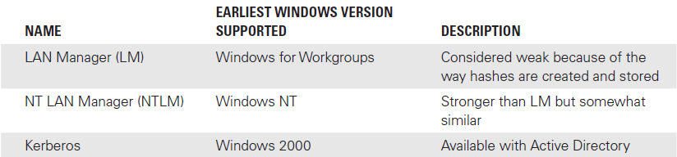
SAM Changes in Windows

Slide 9
Windows Groups
Are used by Windows to grant access to resources and to simplify management
A group can contain a large number of users that can then be managed as a unit
User
User
Group

Slide 10
Windows Security Identifiers (SIDs)
A unique ID for each user account, group, or object in Windows
Example: S-1-5-32-1045337234-12924708993-5683276719-19000
Even though you may use a username to access the system, Windows identifies each user, group, or object by the SID
Once a SID is used it is never reused
An attacker cannot gain access to files or resources simply by naming their account the same as yours

Slide 11
Commonly Attacked and Exploited Services
NetBIOS
UDP port 137
UDP port 138
TCP port 139
Notes:
NetBIOS has long been a target for attackers

Slide 12
Enumeration
Dig deeper into the target system
Uncover specific information about the system
Determine what services and settings are present
Modify attack to make activity more productive

Slide 13
Enumeration (Cont.)
Details that tend to appear during enumeration:
User accounts
Group settings
Group membership
Application settings
Service banners
Audit settings
Other service settings

Slide 14
Enumeration (Cont.)
Enumeration
NULL session
Nbtstat
SuperScan
SNScan

Slide 15
How to Perform Enumeration Tasks
Start with a list of hosts and open, or active, ports (from port scanning phase)
Use hacking utilities to explore these open ports further
SPARTA
Enum4Linux
TheHarvester
SNMPwalk
Sid2user
User2sid

Slide 16
NULL Session
List of users and groups
List of computers and devices
List of shares
Users and host SIDs
Notes:
The NULL session is a feature in the Windows operating system that is used to give access to certain types of information across the network.
A NULL session occurs when a user attempts a connection to a Windows system without providing a standard username and password.
This connection type cannot be made to just any Windows share, but it can be made to an interprocess communication (IPC) administrative share. In normal practice, NULL sessions are designed to allow connections between systems on a network to allow one system to enumerate the processes and shares on another.

Slide 17
NULL Session (Cont.)
To connect to a computer, where the host is the Internet Protocol (IP) address or name of the system being targeted:
net use \\ninja\ipc$ “”/user:””
To view shared folders on a system:
net view \\ninja
If shared resources are available, they will be displayed as a list, at which point the attacker can attach to a shared resource:
net use s:\\ninja\(shared folder name)

Slide 18
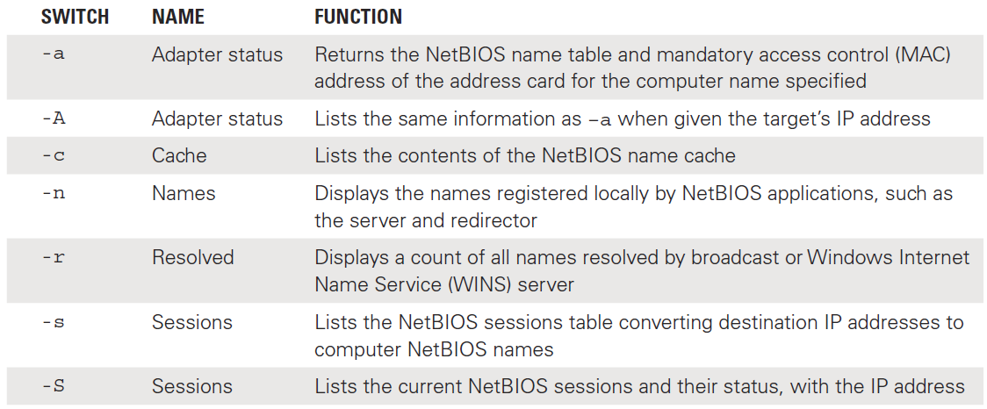
Working with nbstat: Partial List of nbstat Switches
A utility designed to troubleshoot name resolution issues that are a result of the NetBIOS service
nbtstat <switch>

Slide 19
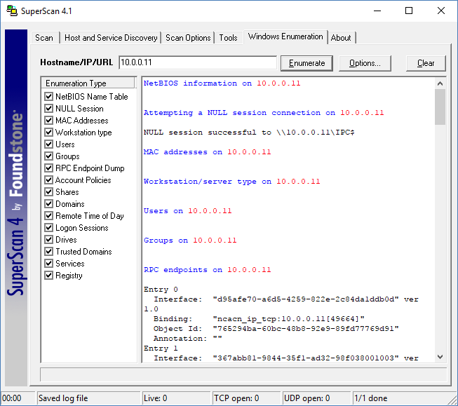
SuperScan
Notes:
SuperScan:
Is a tool used to perform port scanning but can also be used to perform enumeration.
Can scan TCP and UDP ports, perform ping scans, and run Whois and tracert.

Slide 20
Angry IP Scanner
Alternative to SuperScan
Useful for multiple steps in early attack phases
Distributed as open-source software
Runs on Windows, Linux, or MAC OS environments

Slide 21
SNScan
Designed to detect SNMP-enabled devices on a network
Locates and identifies devices that are vulnerable to SNMP attacks
Scans specific ports (for example, UDP 161, 193, 391, and 1993)
Looks for the use of standard (public and private) and user-defined SNMP community names

Slide 22
System Hacking
Covering tracks in log files
Privilege escalation on servers
Enumeration on systems
Password cracking on SAM
System Hacking

Slide 23
Types of Password Cracking
Password Cracking
Passive online attacks
Active online attacks
Offline attacks
Nontechnical attacks
Notes:
Passive Online Attacks: In passive online attacks, an attacker obtains a password simply by listening for it. This attack can be carried out using two methods; packet sniffing, or man-in-the-middle and replay attacks. These types of attacks are successful if the attacker is willing to be patient and employ the right technique in the correct environment.
Active online attacks are effective in situations in which the target system has weak or poorly chosen passwords in use. In such cases, active online attacks can crack passwords very quickly.
Offline attacks are a form of password attack that relies on weaknesses in how passwords are stored on a system. The previous attack types attempted to gain access to a password by capturing it or trying to break it directly; offline attacks go after passwords where they happen to be stored on a system.
The nontechnical methods represent a change over previous attacks; where previous attacks relied on attacking the technology, nontechnical methods go after the human who uses the system. In the right hands, nontechnical methods can be as effective as technical methods at obtaining passwords.

Slide 24
Offline Attacks
Dictionary attacks
Attacker tries all possible combinations until the correct combination is discovered.
Hybrid attacks
Attack begins as a dictionary attack but moves to a second phase that includes characters and symbols if password is not discovered
Brute-force attack
All possible combinations are attempted; takes a long time
Precomputed hashes
Used in rainbow table attacks

Slide 25
Nontechnical Attacks
Shoulder surfing
Keyboard sniffing
Social engineering
Notes:
Shoulder surfing is a method of obtaining a password by observing people entering their passwords. In this attack, the individual wanting to gain access to the password takes a position to see what a user is typing or what is appearing onscreen.
Keyboard sniffing intercepts the password as a user is entering it. This attack can be carried out when users are the victims of keystroke logging software or if they regularly log on to systems remotely without using any protection. Keystroke loggers are available both as software and hardware devices.
Social engineering methods can also be used to obtain a password based on trust or ignorance on the user’s end.
For example, an attacker may call an individual and pretend to be a system administrator or help desk representative.
Most calls start with official-sounding greetings and reasons for the call and then generally move on to a request for the current password.
An alarming number of users will comply and provide their passwords to a “trusted” individual.
Social engineering is effective because users tend to be trusting.

Slide 26
Using Password Cracking: Targets
Administrator account
Lower-level accounts
Guest

Slide 27
Privilege Escalation
To escalate the privileges to a level at which increased access and fewer restrictions are in place, such as with the Administrator account
Often used after a lower-level account is cracked
One way to escalate privileges is to identify account that has desired access and then change the password

Slide 28
Privilege Escalation Tools
Active@ Password Changer
Trinity Rescue Kit
ERD Commander
Recovery Console

Slide 29
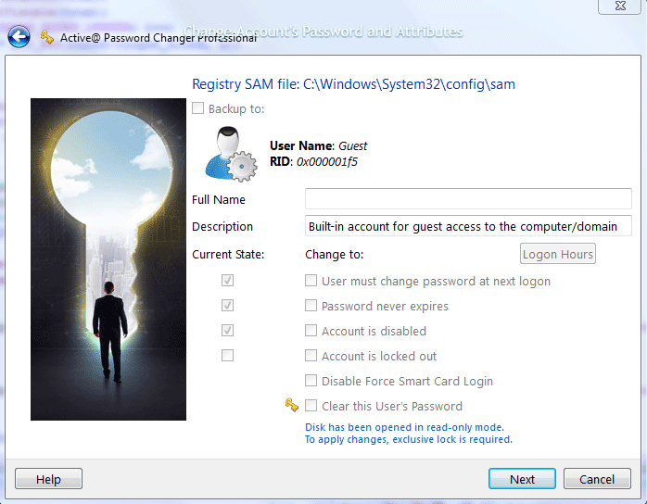
Active@ Password Changer: Viewing Account Information
Notes:
A utility used to perform multiple functions on user accounts, including resetting passwords
Can be used to change a password of a targeted user account to a password that the attacker chooses to set
To use this utility, attacker must gain physical access to a system, at which point the system can be rebooted from a universal serial bus (USB) device or DVD

Slide 30
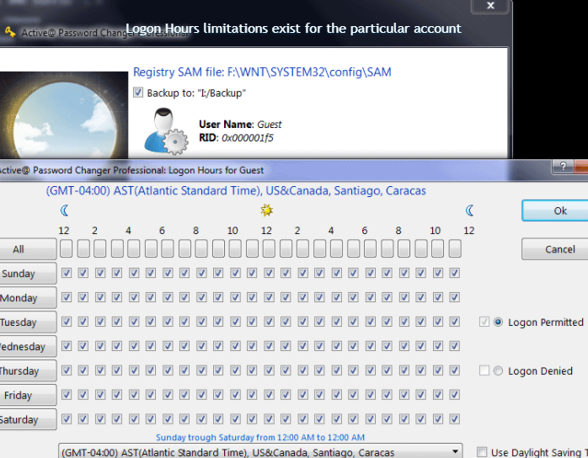
Active@ Password Changer: View and Change Logon

Slide 31
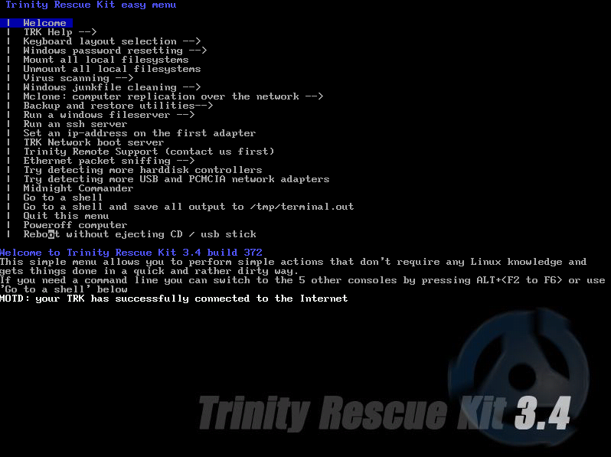
Trinity Rescue Kit (TRK)
Notes:
Trinity Rescue Kit (TRK) is a Linux distribution designed to run from a CD or USB drive.
This example is of the Trinity Rescue Kit main menu.

Slide 32
Planting Backdoors
After escalating privileges, placing a backdoor on a system enables attacker to come back later and take control of the system repeatedly
Some reasons for planting backdoors:
Placing a rootkit
Executing a Trojan horse
Providing easy future access for follow on attacks
To install a backdoor, begin by running an application remotely, such as PsTools

Slide 33
Using PsTools
PsTools suite includes PsExec, designed to run commands interactively or noninteractively on a remote system
Does not require installation on the local or remote system in order to work

Slide 34
PsTools Commands
Launches an interactive command prompt on a system named \\zelda:
psexec \\zelda cmd
Executes ipconfig on remote system with the /all switch; displays resulting output:
psexec \\zelda ipconfig /all

Slide 35
PsTools Commands (Cont.)
Copies program rootkit.exe to remote system and executes it interactively:
psexec \\zelda -c rootkit.exe
Copies program rootkit.exe to remote system and executes it interactively using administrator account on remote system:
psexec \\zelda -u administrator -c rootkit.exe

Slide 36
Rootkits
Designed to alter system files and utilities on a victim’s system to change way the system behaves
Can hide itself from detection
Attacker can gain root access to a system
Can be run with a tool such PsExec

Slide 37
Rootkits (Cont.)
Having root access enables attacker to:
Install a virus
Place a Trojan on a system
Launch a ransomware attack
Install spyware to track activity
Hide attack
Maintain access over the long term
Monitor network traffic
Block the logging of selected events
Redirect output

Slide 38
Covering Tracks
Disabling auditing
If auditing is disabled, attacker can deprive system owner of ability to detect activities that have been carried out
Data hiding
Hiding files placed on the system
Can use file attributes and Alternate Data Streams to hide files

Slide 39
Summary
Process of enumeration, system hacking, and password cracking
Tools used to perform enumeration
Privilege escalation
Importance of covering your tracks
Backdoors

